Slide 1
L3: Virtualization
Prepared by
AVITA KATAL
Assistant Professor(SS)
SoCS,UPES

Slide 2
Contents
Moore’s Law
Recent Advances
Introduction to Virtualization
Virtualization
Characteristics of virtualized environment
Taxonomy of virtualization techniques
6.1 Execution virtualization
6.1.1 Machine reference model
6.1.2. Hardware-level virtualization
Hypervisor

Slide 3
1. Moore’s law
Intel co-founder Gordon Moore is a visionary. His prediction, popularly known as Moore's Law, states that the number of transistors on a chip will double about every two years. Intel and other semiconductor companies kept that pace for over 40 years.
GPU’s performance and functionality have been increasing at a faster pace than Moore’s law.

Slide 4
2. Recent Advances
Multi-core: how to fully harness the power of multi-core? Intel has been trying really hard to make us all program for multi-core!!!
Large scale data: How to manage large scale data? Google, Yahoo, NSF and CRA have been promoting their file systems and MapReduce!!
Parallel processing of data: How to configure clusters to process data in parallel?
Answer:
Virtualization?

Slide 5
3. Introduction to Virtualization
A physical server is typically composed of four major physical components –
Processor
Memory
Network
Storage (adapters and disk drives).

Slide 6
3. Introduction to Virtualization contd…
The VHDL code (VHSIC Hardware Description Language: software) is logically equivalent to a hardware processor. Given a physical processor, it is possible to represent the logic function in an equivalent VHDL code.
The hardware-software logical conversion is generally a tradeoff between performance and flexibility.
VHDL code is easier to modify and simulate than a physical processor. A physical processor once fabricated cannot be changed. However, the performance of simulation using VHDL is much slower than a physical processor.
Based on the principle of hardware-software equivalence, it is possible to logically convert the system hardware components required to run an OS/application, to their software equivalent or a virtual machine.
The virtual machine can then be replicated to create multiple virtual machines each running its own instance of the OS and the application.
A hypervisor layer is required to multiplex the actual real hardware resources among the virtual machines. The hypervisor is responsible for allocating memory, CPU resources, network and storage to each virtual machine.
Notes:
The VHDL code (software) is logically equivalent to a hardware processor. The VHDL code
can be synthesized and fabricated into a physical processor. On the other hand, given a
physical processor, it is possible to represent the logic function in an equivalent VHDL code.
Similarly, in the second example, we see a CDROM storage that can be converted into an
iso software image. It is also possible to convert/burn the image back to a CDROM.
Logically these two are equivalent.
The hardware-software logical conversion is generally a tradeoff between performance and
flexibility.
VHDL code is easier to modify and simulate than a physical processor. A physical processor
once fabricated cannot be changed. However, the performance of simulation using VHDL is
much slower than a physical processor.
Based on the principle of hardware-software equivalence, it is possible to logically convert the
system hardware components required to run an OS/application, to their software equivalent
or a virtual machine (orange box in the diagram). The virtual machine can then be replicated
to create multiple virtual machines each running its own instance of the OS and the
application. A hypervisor layer (marked in light-green) is required to multiplex the actual real
hardware resources among the virtual machines. The hypervisor is responsible for allocating
memory, CPU resources, network and storage to each virtual machine.

Slide 9
4. Virtualization
Virtualization is creation of an alternative to actual version of something:
virtual memory (more memory than physically available),
virtual time (buffering provides virtual/effective download time that less than the actual time),
Virtual hardware, desktop, disk, appliances, scenes,
Virtual worlds
In our context it is realizing one or more complete computer systems as guests on the base machine/operating system,
OR
Virtualization is way to run multiple operating systems and user applications on the same hardware
E.g., run both Windows and Linux on the same laptop
This offers an excellent conduit for delivering the vastly underutilized power of the multi-core and other resources such as storage and devices.

Slide 11
Virtualization technologies have gained renewed interested recently due to the confluence of several phenomena:
1. Increased performance and computing capacity.
(supercomputers and desktops)
2. Underutilized hardware and software resources.
(administrative or IT automation tasks)
3. Lack of space (server consolidation)
4. Greening initiatives. (carbon footprint for cooling these servers)
5. Rise of administrative costs.
( administration tasks: hardware monitoring, defective hardware replacement, server set up and updates, server resources monitoring, and backups.)
Notes:
1. Increased performance and computing capacity: Now a days, the average end-user desktop PC is powerful enough to meet almost all the needs of everyday computing, with extra capacity that is rarely used.
Almost all these PCs have resources enough to host a virtual machine manager and execute a virtual machine with by far acceptable performance. The same consideration applies to the high-end side of the PC market, where supercomputers can provide immense compute power that can accommodate the execution of hundred of thousands of virtual machines.
2. Underutilized hardware and software resources:
Hardware and software underutilization is occurring due to(1)increased performance and computing capacity, and (2)the effect of limited or sporadic use of resources. Computers today are so powerful that in most cases only a fraction of their capacity is used by an application or the system. Moreover, if we consider the IT infrastructure of an enterprise, many computers are only partially utilized whereas they could be used without interruption on a 24/7/365 basis. For example, desktop PCs mostly devoted to office automation tasks and used by administrative staff are only used during work hours, remaining completely unused overnight. Using these resources for other purposes after hours could improve the efficiency of the IT infrastructure. To transparently provide such a service, it would be necessary to deploy a completely separate environment, which can be achieved through virtualization.
3. Lack of space :
The continuous need for additional capacity, whether storage or compute power, makes data centers grow quickly. Companies such as Google and Microsoft expand their Infrastructures by building data centers as large as football fields that are able to host thousands of nodes. Although this is viable for IT giants, in most cases enterprises cannot afford to build another data center to accommodate additional resource capacity. This condition, along with hardware underutilization , has led to the diffusion of a technique called server consolidation, for which virtualization technologies are fundamental.
4. Greening initiatives.
Recently, companies are increasingly looking for ways to reduce the amount of energy they consume and to reduce their carbon footprint. Data centers are one of the major power consumers; they contribute consistently to the impact that a company has on the environment. Maintaining a data center operation not only involves keeping servers on, but a great deal of energy is also consumed in keeping them cool. Infrastructures for cooling have a significant impact on the carbon footprint of a data center. Hence, reducing the number of servers through server consolidation will definitely reduce the impact of cooling and power consumption
5. Rise of administrative costs.
Power consumption and cooling costs have now become higher than the cost of IT equipment. Moreover, the increased demand for additional capacity, which translates into more servers in a data center, is also responsible for a significant increment in administrative costs. Computers—in particular, servers—do not operate all on their own, but they require care and feeding from system administrators. Common system administration tasks include hardware monitoring, defective hardware replacement, server set up and updates, server resources monitoring, and backups. These are labor-intensive operations, and the higher the number of servers that have to be managed, the higher the administrative costs. Virtualization can help reduce the number of required servers for a given workload, thus reducing the cost of the administrative personnel.

Slide 12
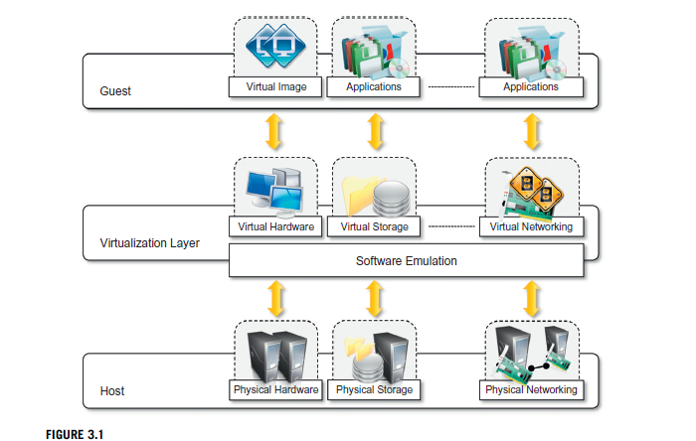

Slide 13
Virtualization is a broad concept that refers to the creation of a virtual version of something, whether hardware, a software environment, storage, or a network.
In a virtualized environment there are three major components: guest, host, and virtualization layer.
The guest represents the system component that interacts with the virtualization layer rather than with the host, as would normally happen.
The host represents the original environment where the guest is supposed to be managed.
The virtualization layer is responsible for recreating the same or a different environment where the guest will operate.

Slide 14
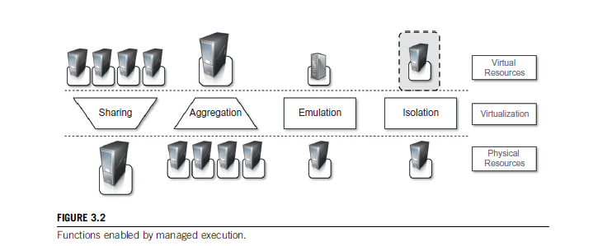
5. Characteristics of virtualized environment
The technologies of today allow profitable use of virtualization and make it possible to fully exploit the advantages that come with it. Such advantages have always been characteristics of virtualized solutions.
Increased security
Managed execution
Sharing
Aggregation:
Emulation
Isolation
Performance Tuning
3. Portability
Notes:
1. Increased security
The ability to control the execution of a guest in a completely transparent manner opens new possibilities for delivering a secure, controlled execution environment. The virtual machine represents an emulated environment in which the guest is executed. All the operations of the guest are generally performed against the virtual machine, which then translates and applies them to the host. This level of indirection allows the virtual machine manager to control and filter the activity of the guest, thus preventing some harmful operations from being performed.
Resources exposed by the host can then be hidden or simply protected from the guest. Moreover Sensitive information that is contained in the host can be naturally hidden without the need to install complex security policies.
For example, applets downloaded from the Internet run in a sandboxed version of the Java Virtual Machine(JVM),which provides them with limited access to the hosting operating system resources.
2. Managed Execution
a. Sharing : Virtualization allows the creation of a separate computing environments within the same host. In this way it is possible to fully exploit the capabilities of a powerful guest, which would otherwise be underutilized. Sharing is a particularly important feature in virtualized data centers, where this basic feature is used to reduce the number of active servers and limit power consumption.
b. Aggregation. Not only is it possible to share physical resource among several guests, but virtualization also allows aggregation, which is the opposite process. A group of separate hosts can be tied together and represented to guests as a single virtual host. This function is naturally implemented in middleware for distributed computing, with a classical example represented by cluster management software, which harnesses the physical resources of a homogeneous group of machines and represents them as a single resource.
c. Emulation. Guest programs are executed within an environment that is controlled by the virtualization layer, which ultimately is a program. This allows for controlling and tuning the environment that is exposed to guests. For instance, a completely different environment with respect to the host can be emulated, thus allowing the execution of guest programs requiring specific characteristics that are not present in the physical host.
This feature becomes very useful for testing purposes, where a specific guest has to be validated against different platforms or architectures and the wide range of options is not easily accessible during development.
Again, hardware virtualization solutions are able to provide virtual hardware and emulate a particular kind of device such as Small Computer System Interface (SCSI) devices for file I/O, without the hosting machine having such hardware installed. Old and legacy software that does not meet the requirements of current systems can be run on emulated hardware without any need to change the code. This is possible either by emulating the required hardware architecture or within a specific operating system sandbox, such as the MS-DOS mode in Windows 95/98. Another example of emulation is an arcade-game emulator that allows us to play arcade games on a normal personal computer.
d. Isolation : Virtualization allows providing guests—whether they are operating systems, applications, or other entities—with a completely separate environment, in which they are executed. The guest program performs its activity by interacting with an abstraction layer, which provides access to the underlying resources.
Isolation brings several benefits; for example, it allows multiple guests to run on the same host without interfering with each other. Second, it provides a separation between the host and the guest. The virtual machine can filter the activity of the guest and prevent harmful operations against the host.
Performance tuning: Besides these characteristics, another important capability enabled by virtualization is performance tuning. This feature is a reality at present, given the considerable advances in hardware and software supporting virtualization. It becomes easier to control the performance of the guest by finely tuning the properties of the resources exposed through the virtual environment.
This capability provides a means to effectively implement a quality-of-service (QoS) infrastructure that more easily fulfills the service-level agreement (SLA) established for the guest. For instance, software-implementing hardware virtualization solutions can expose to a guest operating system only a fraction of the memory of the host machine or set the maximum frequency of the processor of the virtual machine. Another advantage of managed execution is that sometimes it allows easy capturing of the state of the guest program, persisting it, and resuming its execution. This, for example, allows virtual machine managers such as Xen Hypervisor to stop the execution of a guest operating system, move its virtual image into another machine, and resume its execution in a completely transparent manner. This technique is called virtual machine migration and constitutes an important feature in virtualized data centers for optimizing their efficiency in serving application demands.
3. Portability
The concept of portability applies in different ways according to the specific type of virtualization considered. In the case of a hardware virtualization solution, the guest is packaged into a virtual image that, in most cases, can be safely moved and executed on top of different virtual machines. Except for the file size, this happens with the same simplicity with which we can display a picture image in different computers.
Virtual images are generally proprietary formats that require a specific virtual machine manager to be executed.
In the case of programming-level virtualization, as implemented by the JVM or the .NET runtime, the binary code representing application components (jars or assemblies) can be run without any recompilation on any implementation of the corresponding virtual machine. This makes the application development cycle more flexible and application deployment very straight forward: One version of the application, in most cases, is able to run on different platforms with no changes. Finally, portability allows having your own system always with you and ready to use as long as the required virtual machine manager is available. This requirement is, in general, less stringent than having all the applications and services you need available to you anywhere you go.

Slide 15
6. Taxonomy of virtualization techniques
The first classification discriminates against the service or entity that is being emulated.
Virtualization is mainly used to emulate execution environments, storage, and networks.
Among these categories, execution virtualization constitutes the oldest, most popular, and most developed area.
Virtualization techniques can be divided into two major categories by considering the type of host they require.
Process-level techniques are implemented on top of an existing operating system, which has full control of the hardware.
System-level techniques are implemented directly on hardware and do not require—or require a minimum of support from—an existing operating system.

Slide 16
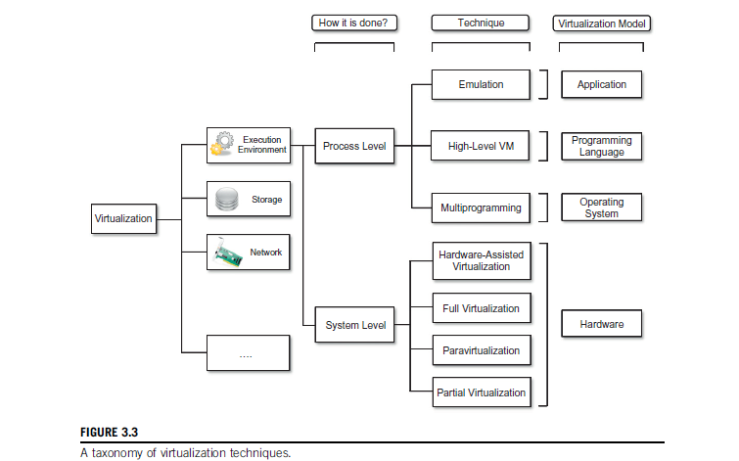
6. Taxonomy of virtualization techniques contd…

Slide 17
6.1. Execution virtualization
Execution virtualization includes all techniques that aim to emulate an execution environment that is separate from the one hosting the virtualization layer.
All these techniques concentrate their interest on providing support for the execution of programs, whether these are the operating system, a binary specification of a program compiled against an abstract machine model, or an application.
Execution virtualization can be implemented directly on top of the hardware by the operating system, an application, or libraries dynamically or statically linked to an application image.

Slide 18
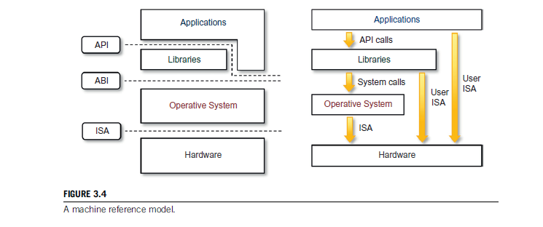
6.1.1 Machine reference model
Virtualization techniques actually replace one of the layers and intercept the calls that are directed toward it.
Therefore, a clear separation between layers simplifies their implementation, which only requires the emulation of the interfaces and a proper interaction with the underlying layer.
This layered approach simplifies the development and implementation of computing systems and simplifies the implementation of multitasking and the coexistence of multiple executing environments.
Notes:
At the bottom layer, the model for the hardware is expressed in terms of the Instruction Set Architecture (ISA), which defines the instruction set for the processor, registers, memory, and interrupt management.
ISA is the interface between hardware and software, and it is important to the operating system (OS) developer (System ISA) and developers of applications that directly manage the underlying hardware (User ISA).
The application binary interface (ABI) separates the operating system layer from the applications and libraries, which are managed by the OS. ABI covers details such as low-level data types, alignment, and call conventions and defines a format for executable programs. System calls are defined at this level. This interface allows portability of applications and libraries across operating systems that implement the same ABI.
The highest level of abstraction is represented by the application programming interface (API), which interfaces applications to libraries and/or the underlying operating system.
For any operation to be performed in the application level API, ABI and ISA are responsible for making it happen. The high-level abstraction is converted into machine-level instructions to perform the actual operations supported by the processor.
This layered approach simplifies the development and implementation of computing systems and simplifies the implementation of multitasking and the coexistence of multiple executing environments

Slide 19
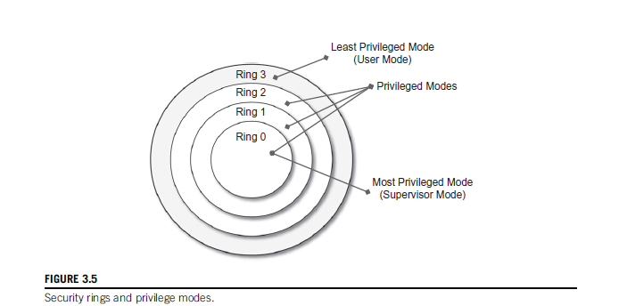
6.1.1 Machine reference model contd…
The instruction set exposed by the hardware has been divided into different security classes that define who can operate with them.
Privileged and Non privileged instructions
Notes:
The instruction set exposed by the hardware has been divided into different security classes that define who can operate with them. The first distinction can be made between privileged and non privileged instructions.
Non privileged instructions are those instructions that can be used without interfering with other tasks because they do not access shared resources. This category contains, for example, all the floating, fixed-point, and arithmetic instructions.
Privileged instructions are those that are executed under specific restrictions and are mostly used for sensitive operations, which expose (behavior-sensitive) or modify (control-sensitive) the privileged state. For instance, behavior-sensitive instructions are those that operate on the I/O, whereas control-sensitive instructions alter the state of the CPU registers.
Some types of architecture feature more than one class of privileged instructions and implement a finer control of how these instructions can be accessed.
For instance, a possible implementation features a hierarchy of privileges in the form of ring-based security: Ring 0, Ring 1, Ring 2, and Ring 3; Ring 0 is in the most privileged level and Ring 3 in the least privileged level. Ring 0 is used by the kernel of the OS, rings 1 and 2 are used by the OS-level services, and Ring 3 is used by the user.
Recent systems support only two levels, with Ring 0 for supervisor mode and Ring 3 for user mode.
The first mode denotes an execution mode in which all the instructions (privileged and non privileged) can be executed without any restriction. This mode, also called master mode or kernel mode, is generally used by the operating system (or the hypervisor) to perform sensitive operations on hardware-level resources.
In user mode, there are restrictions to control the machine-level resources. If code running in user mode invokes the privileged instructions, hardware interrupts occur and trap the potentially harmful execution of the instruction. Despite this, there might be some instructions that can be invoked as privileged instructions under some conditions and as non privileged instructions under other conditions.
The distinction between user and supervisor mode allows us to understand the role of the hypervisor and why it is called that. Conceptually, the hypervisor runs above the supervisor mode, and from here the prefix hyper- is used. In reality, hypervisors are run in supervisor mode, and the division between privileged and non privileged instructions has posed challenges in designing virtual machine managers. It is expected that all the sensitive instructions will be executed in privileged mode, which requires supervisor mode in order to avoid traps.
Without this assumption it is impossible to fully emulate and manage the status of the CPU for guest operating systems. Unfortunately, this is not true for the original ISA, which allows 17 sensitive instructions to be called in user mode. This prevents multiple operating systems managed by a single hypervisor to be isolated from each other, since they are able to access the privileged state of the processor and change it. More recent implementations of ISA (Intel VT and AMD Pacifica) have solved this problem by redesigning such instructions as privileged ones.

Slide 20
6.1.2. Hardware-level virtualization/System Level Virtualization
Hardware-level virtualization is a virtualization technique that provides an abstract execution environment in terms of computer hardware on top of which a guest operating system can be run.
In this model, the guest is represented by the operating system, the host by the physical computer hardware, the virtual machine by its emulation, and the virtual machine manager by the hypervisor.
The hypervisor is generally a program or a combination of software and hardware that allows the abstraction of the underlying physical hardware.
Hardware-level virtualization is also called system virtualization, since it provides ISA to virtual machines, which is the representation of the hardware interface of a system. This is to differentiate it from process virtual machines, which expose ABI to virtual machines.

Slide 21
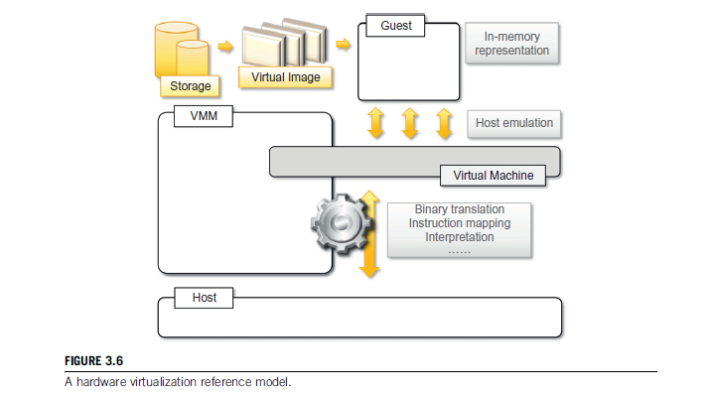
6.1.2. Hardware-level virtualization contd…

Slide 22
Hypervisors
A fundamental element of hardware virtualization is the hypervisor, or virtual machine manager (VMM).
It recreates a hardware environment in which guest operating systems are installed.
There are two major types of hypervisor: Type I and Type II
Type I
Type I hypervisors run directly on top of the hardware.
Therefore, they take the place of the operating systems and interact directly with the ISA interface exposed by the underlying hardware, and they emulate this interface in order to allow the management of guest operating systems.
This type of hypervisor is also called a Native Virtual Machine/Bare metal since it runs natively on hardware.

Slide 23
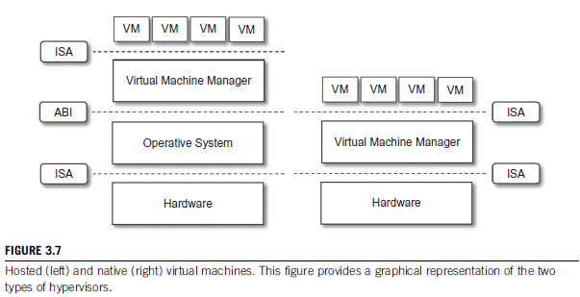
Type II
Hypervisors require the support of an operating system to provide virtualization services.
This means that they are programs managed by the operating system, which interact with it through the ABI and emulate the ISA of virtual hardware for guest operating systems.
This type of hypervisor is also called a hosted virtual machine since it is hosted within an operating system.

Slide 24
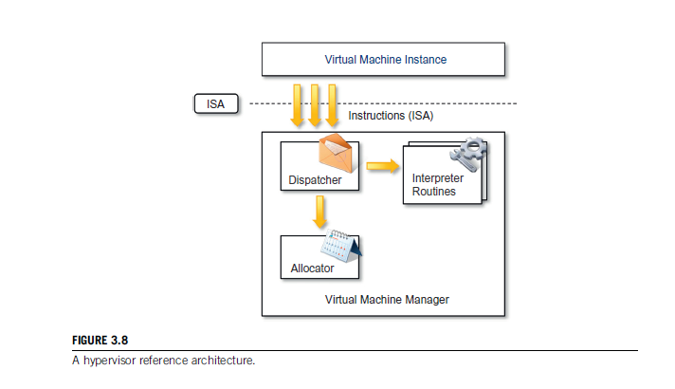
HYPERVISOR contd…
Three main modules
Dispatcher
Allocator
Interpreter
coordinate their activity in order to emulate the
underlying hardware.
The Dispatcher constitutes the entry point of the monitor and reroutes the instructions issued by the virtual machine instance to one of the two other modules.
The Allocator is responsible for deciding the system resources to be provided to the VM: whenever a virtual machine tries to execute an instruction that results in changing the machine resources associated with that VM, the allocator is invoked by the dispatcher.
The interpreter module consists of interpreter routines. These are executed whenever a virtual machine executes a privileged instruction: a trap is triggered and the corresponding routine is executed.

Slide 25
HYPERVISOR contd…
The criteria that need to be met by a virtual machine manager to efficiently support virtualization were established by Goldberg and Popek in 1974. Three properties have to be satisfied:
Equivalence: A guest running under the control of a virtual machine manager should exhibit the same behaviour as when it is executed directly on the physical host.
Resource control: The virtual machine manager should be in complete control of virtualized resources.
Efficiency: A statistically dominant fraction of the machine instructions should be executed without intervention from the virtual machine manager.

Slide 26
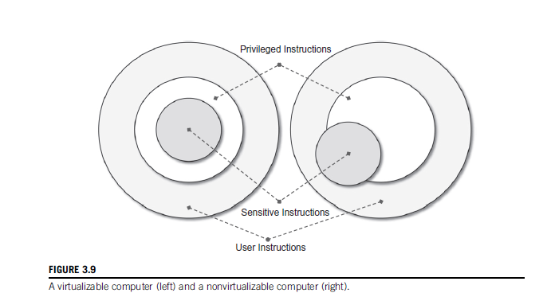
Popek and Goldberg provided a classification of the instruction set and proposed three theorems that define the properties that hardware instructions need to satisfy:
THEOREM 1
For any conventional third-generation computer, a VMM may be constructed if the set of sensitive instructions for that computer is a subset of the set of privileged instructions.
Notes:
This theorem establishes that all the instructions that change the configuration of the system resources should generate a trap in user mode and be executed under the control of the virtual machine manager. This allows hypervisors to efficiently control only those instructions that would reveal the presence of an abstraction layer while executing all the rest of the instructions without considerable performance loss. The theorem always guarantees the resource control property when the hypervisor is in the most privileged mode (Ring 0). The non privileged instructions must be executed without the intervention of the hypervisor. The equivalence property also holds good since the output of the code is the same in both cases because the code is not changed.

Slide 27
THEOREM 2
A conventional third-generation computer is recursively virtualizable if:
It is virtualizable and
A VMM without any timing dependencies can be constructed for it.
THEOREM 3
A hybrid VMM may be constructed for any conventional third-generation machine in which the set of user-sensitive instructions is a subset of the set of privileged instructions.
Notes:
THEOREM 2
Recursive virtualization is the ability to run a virtual machine manager on top of another virtual machine manager. This allows nesting hypervisors as long as the capacity of the underlying resources can accommodate that. Virtualizable hardware is a prerequisite to recursive virtualization
THEOREM 3
There is another term, hybrid virtual machine (HVM), which is less efficient than the virtual machine system. In the case of an HVM, more instructions are interpreted rather than being executed directly. All instructions in virtual supervisor mode are interpreted. Whenever there is an attempt to execute a behavior-sensitive or control-sensitive instruction, HVM controls the execution directly or gains the control via a trap. Here all sensitive instructions are caught by HVM that are simulated
This reference model represents what we generally consider classic virtualization—that is, the ability to execute a guest operating system in complete isolation. To a greater extent, hardware-level virtualization includes several strategies that differentiate from each other in terms of which kind of support is expected from the underlying hardware, what is actually abstracted from the host, and whether the guest should be modified or not.

